Slide 1
K-Means
Aakash Goel

Slide 2
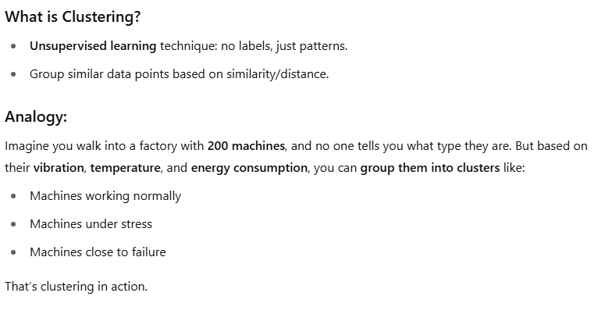
Clustering

Slide 3
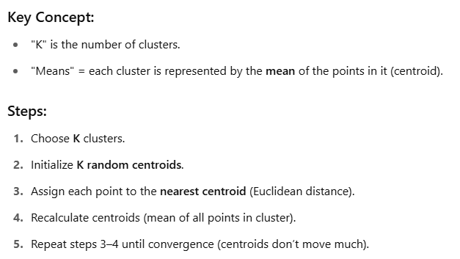
K-Means: Step by Step

Slide 4
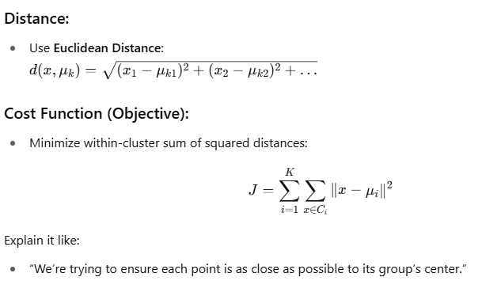
Math behind K-Means

Slide 5
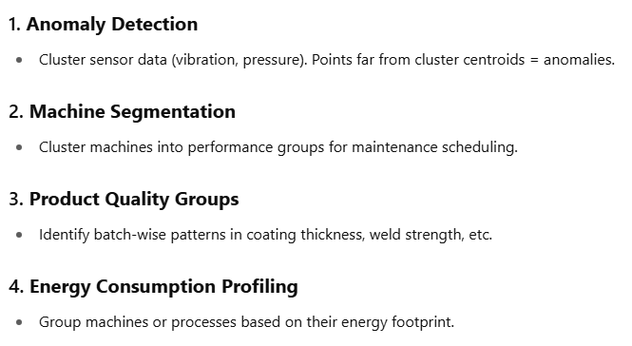
Use-cases in Smart Manufacturing

Slide 6
Code Demo
from sklearn.cluster import KMeans
import numpy as np
import matplotlib.pyplot as plt
# Sample manufacturing-like data (vibration, temp)
X = np.array([[20, 80], [22, 82], [21, 79],
[35, 20], [36, 22], [34, 19],
[60, 60], [59, 58], [61, 62]])
# Fit model
kmeans = KMeans(n_clusters=3, random_state=0).fit(X)
# Print centroids
print("Centroids:", kmeans.cluster_centers_)
print("Labels:", kmeans.labels_)
# Plot clusters
plt.scatter(X[:, 0], X[:, 1], c=kmeans.labels_, cmap='rainbow')
plt.scatter(kmeans.cluster_centers_[:, 0], kmeans.cluster_centers_[:, 1], s=200, marker='X', c='black')
plt.xlabel("Vibration")
plt.ylabel("Temperature")
plt.title("Machine Clustering by K-Means")
plt.show()

Slide 7
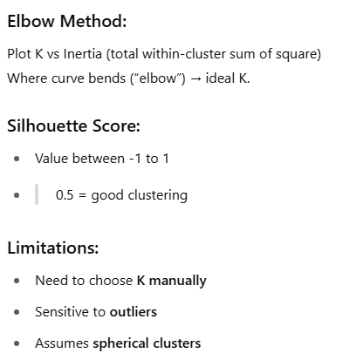
Limitation + Evaluation

